Slide 1
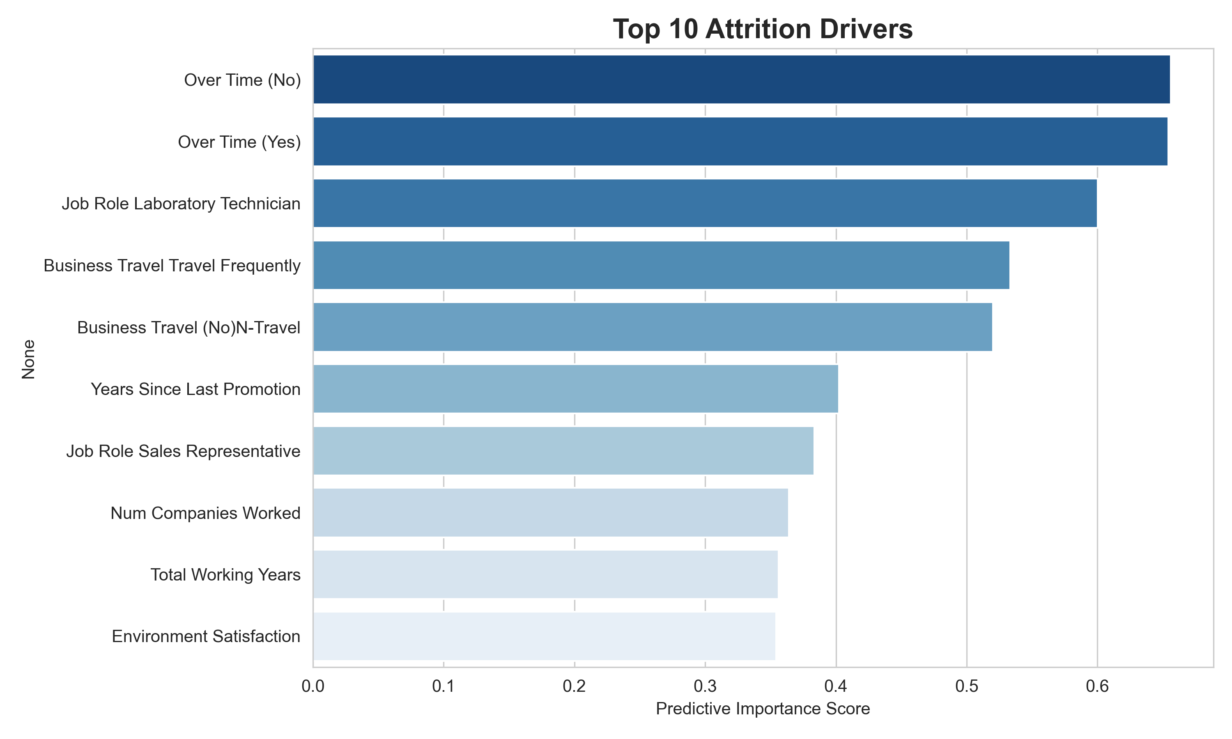
Who Will Resign -- Key Drivers
Results:
Accuracy: 0.779
ROC-AUC: 0.812
Recall: 0.681
F1: 0.496
Key Remarks:
Over Time (No) is among the strongest predictors of attrition.
Over Time (Yes) is among the strongest predictors of attrition.
Job Role Laboratory Technician is among the strongest predictors of attrition.
Best model after tuning: Logistic Regression (81.2% ROC-AUC).

Slide 2
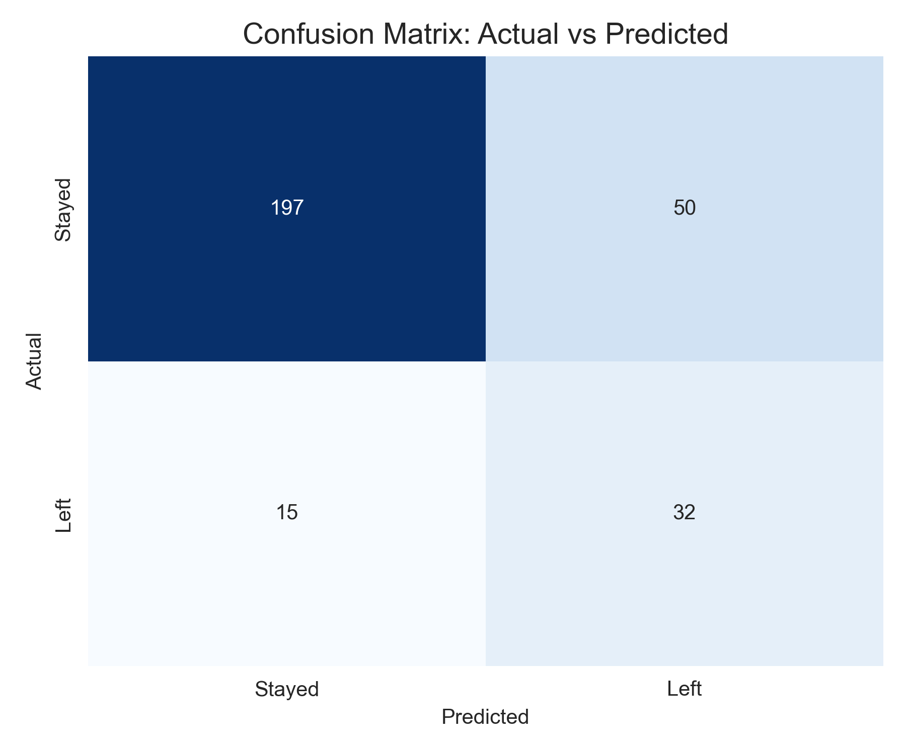
Model Accuracy -- Validation
Results:
Accuracy: 0.779
Precision: 0.390
Recall: 0.681
F1: 0.496
Key Remarks:
229.0 of 294 held-out employees (77.9%) were classified correctly.
The model catches 68.1% of employees who actually left (recall).

Slide 3
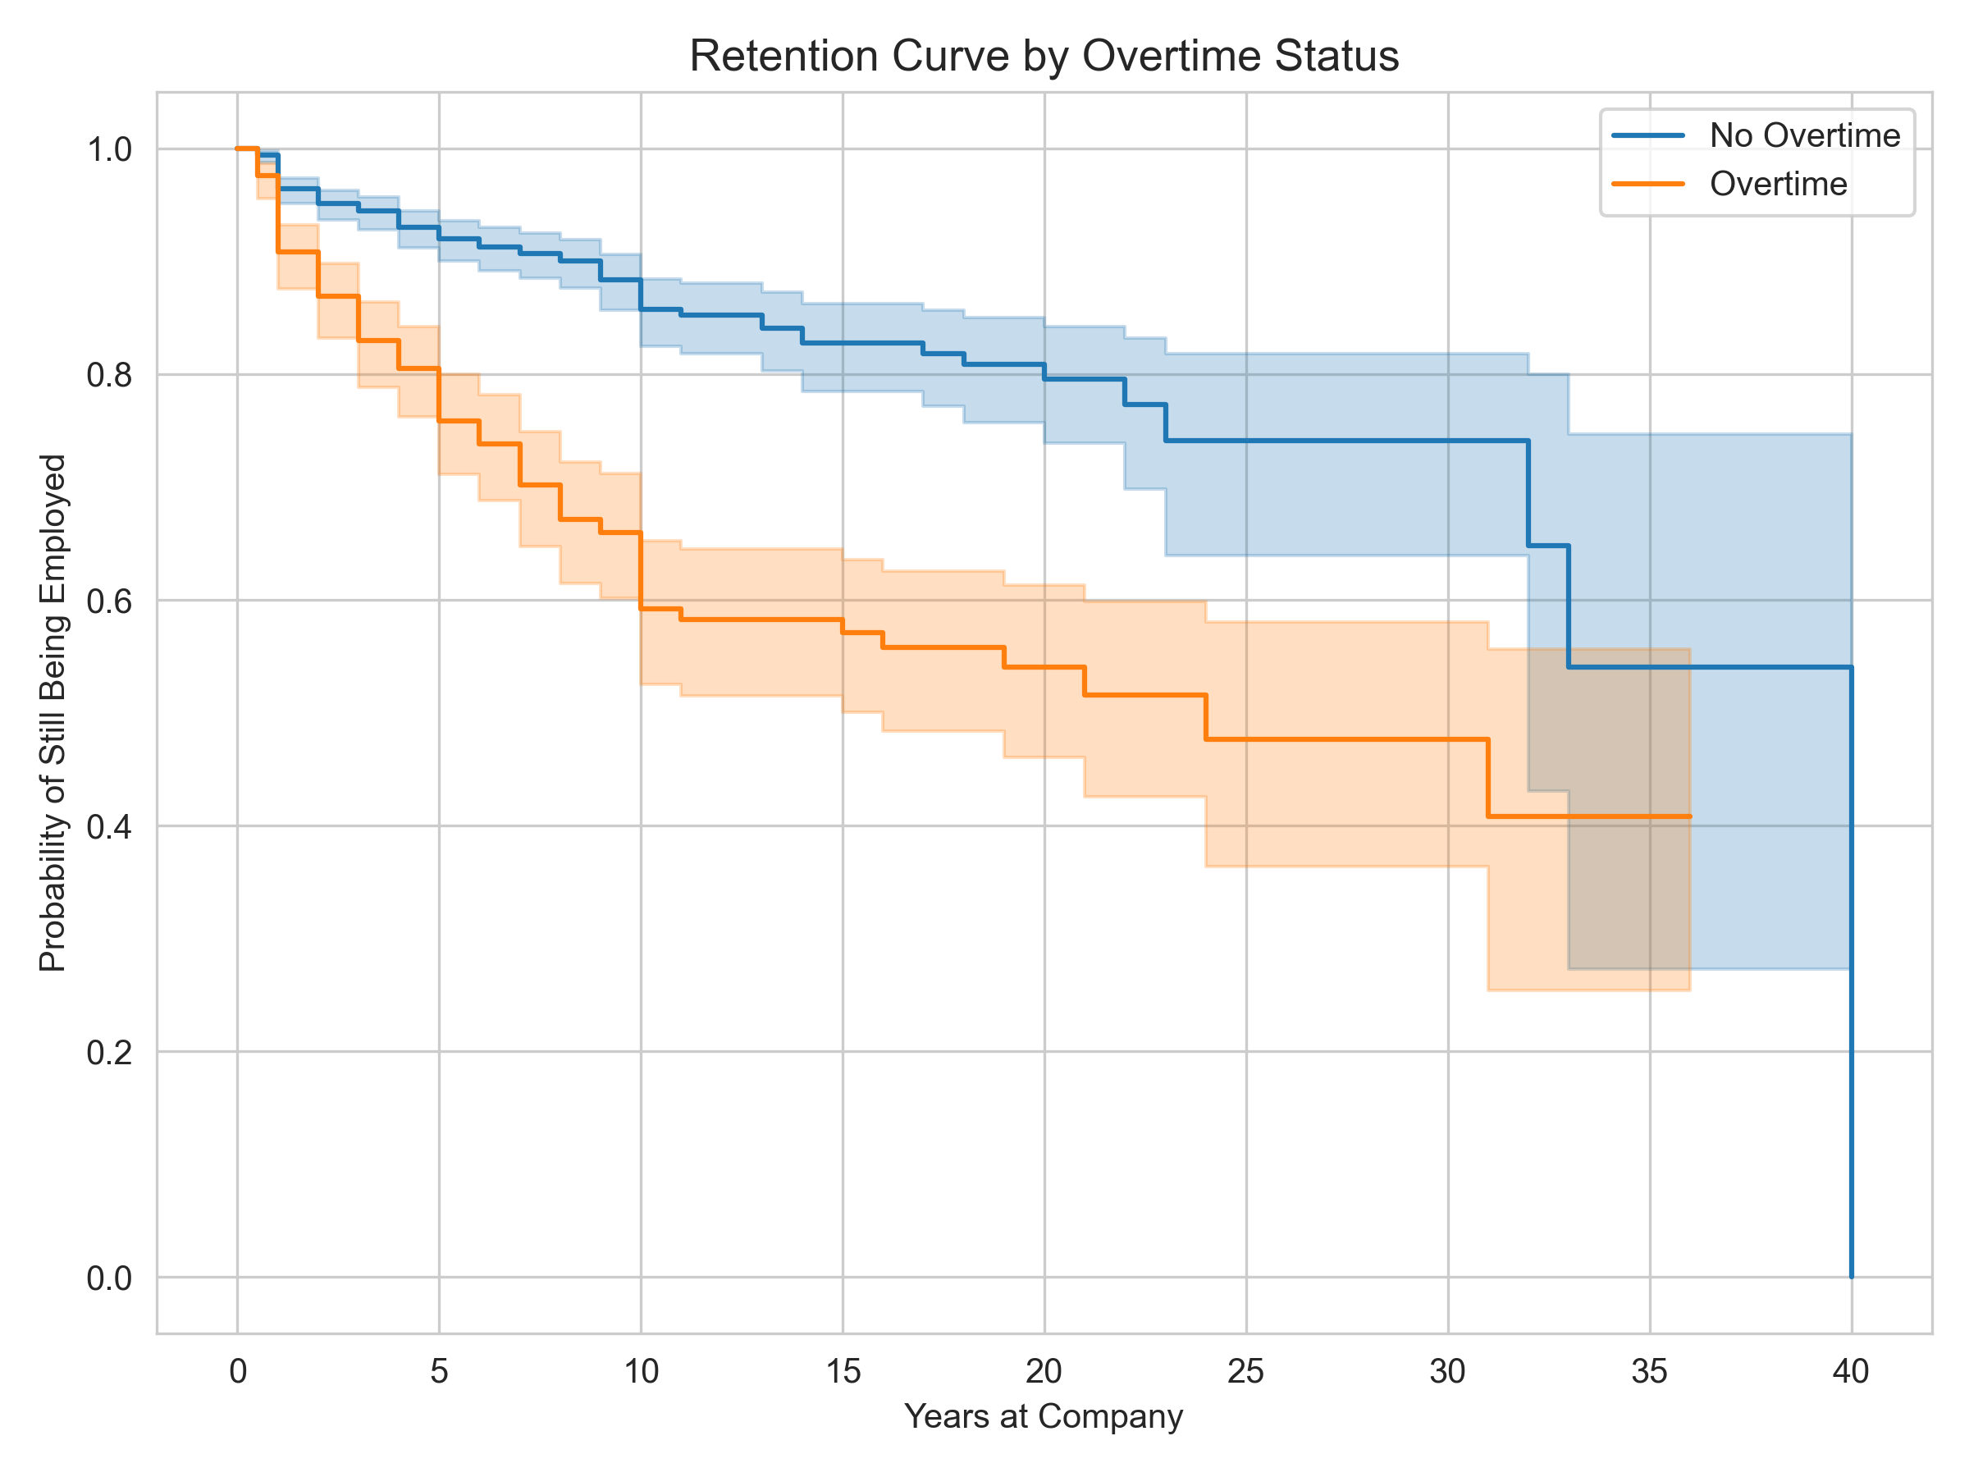
When Will They Resign -- Survival Analysis
Results:
Train C-index: 0.849
Test C-index: 0.846
Key Remarks:
Over Time (Yes) raises the hazard of leaving by 101%.
Marital Status Single raises the hazard of leaving by 43%.
Num Companies Worked raises the hazard of leaving by 9%.
Test concordance index: 0.846 (0.5 = random, 1.0 = perfect ranking).
Overtime vs. no-overtime retention gap is statistically significant (log-rank p = 1.6e-19).

